Slide 1
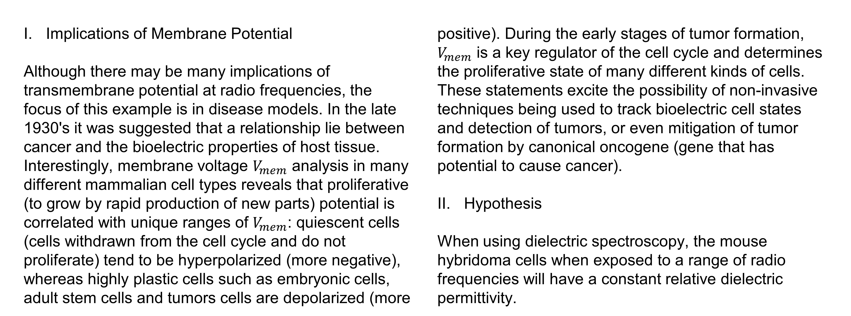
Synthetic Biology
Students: Advised by:
Nicolette Lippert Dr. Ewert
Andrew Bossert Jared Hanson
Christopher Jordan-Denny
Implications of Membrane Potential
Although there may be many implications of transmembrane potential at radio frequencies, the focus of this example is in disease models. In the late 1930's it was suggested that a relationship lie between cancer and the bioelectric properties of host tissue. Interestingly, membrane voltage $V_{mem}$ analysis in many different mammalian cell types reveals that proliferative (to grow by rapid production of new parts) potential is correlated with unique ranges of $V_{mem}$: quiescent cells (cells withdrawn from the cell cycle and do not proliferate) tend to be hyperpolarized (more negative), whereas highly plastic cells such as embryonic cells, adult stem cells and tumors cells are depolarized (more positive). During the early stages of tumor formation, $V_{mem}$ is a key regulator of the cell cycle and determines the proliferative state of many different kinds of cells. These statements excite the possibility of non-invasive techniques being used to track bioelectric cell states and detection of tumors, or even mitigation of tumor formation by canonical oncogene (gene that has potential to cause cancer).
Hypothesis
When using dielectric spectroscopy, the mouse hybridoma cells when exposed to a range of radio frequencies will have a constant relative dielectric permittivity.

